Slide 1



Exploring the Effect of Personalized Virtual Reality
Serious Game for Stroke Rehabilitation
MAPDE 2025/2026 - Investigation Plan Presentation
David Palricas - 108780
Mentors:
Professor Bernardo Marques
Professor Beatriz Santos

Slide 2
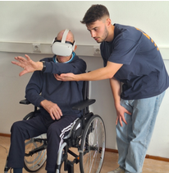

INTRODUCTION
Why this Project?
How does stroke impacts our society?
Why VR for rehabilitation?
2

Slide 3



GOALS
Develop a Functional Game Prototype
Implement algorithms/rules for dynamic difficulty adjustment based on user performance.
Test the protype with users
3

Slide 4



BENEFITS
Contribute to VR Rehabilitation Research
Increase survivors’ motivation
Improves surviors’ progress
4

Slide 5
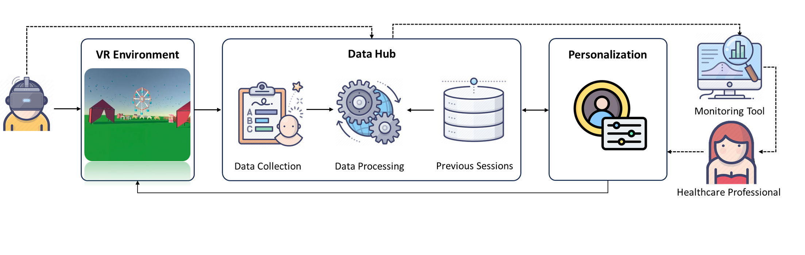
CONCEPTUAL FRAMEWORK
5

Slide 6








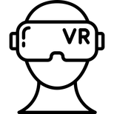
METHODOLOGY
This project will adopt the Human-Centered Design (HCD)
State Of Art Review
2. Analysis of Previous Studies/Questionnaire
8. Fine Tunning
*
3. Game Concept
7. Data Analysis
*
4. Define the Personalized Parameters
*
6. User Evaluation
5. Game Prototype
6

Slide 7
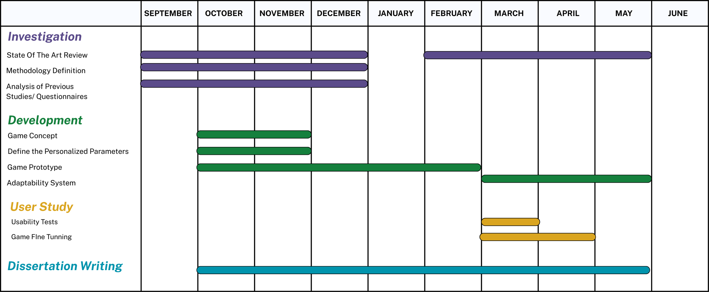
TIMELINE
7

Slide 8
EXPECTED RESULTS
Answer the Research Question
Can VR based environments be personalized to adjust to individual need and help boost motivation?
At a development level
Have different variations of the functional prototype to test different approachs of dynamic difficulty adjustment
At a therapeutically level
Reinforce the use of serious games with virtual reality environments as as complementary methods to the traditional ones to boost survivors motivation and engagement
8

Slide 9
The End
Thank You For Listening

